Slide 1

Introduction to Machine Learning
What is Machine Learning?

Slide 2
Copyright Notice
The material within this presentation, excluding externally sourced images and animations, is fully owned by the Curtin Machine Learning Club. No redistributing, modification, nor commercialisation is allowed without written consent from the copyright holder.
Copyright © 2022 Curtin Machine Learning Club

Slide 3
Acknowledgement of Country
Curtin University would like to pay our respect to the Aboriginal and Torres Strait Islander members of our community by acknowledging the traditional owners of the land on which the Bentley Campus is located, the Wadjuk people of the Nyungar Nation; and on our Kalgoorlie Campus, the Wongutha people of the North-Eastern Goldfields, past, present, and emerging.

Slide 4
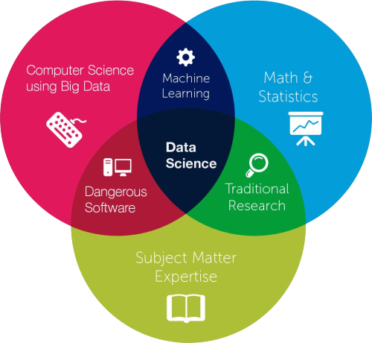

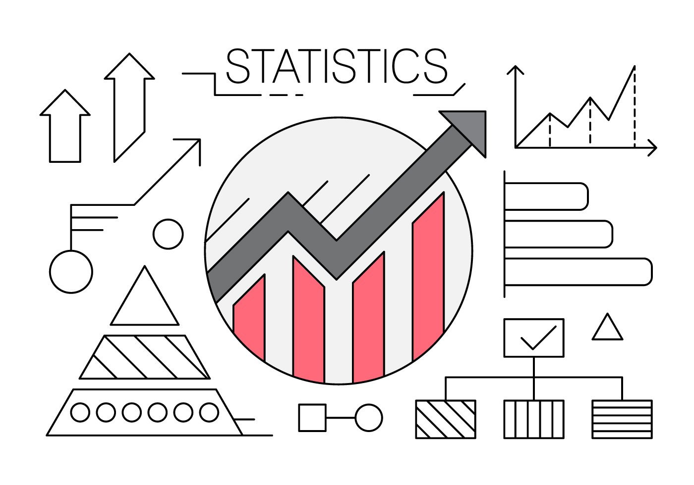

What are we studying?

Slide 5


Hardware Required

Slide 6
No programming experience needed!
But some Python is nice…

Slide 7
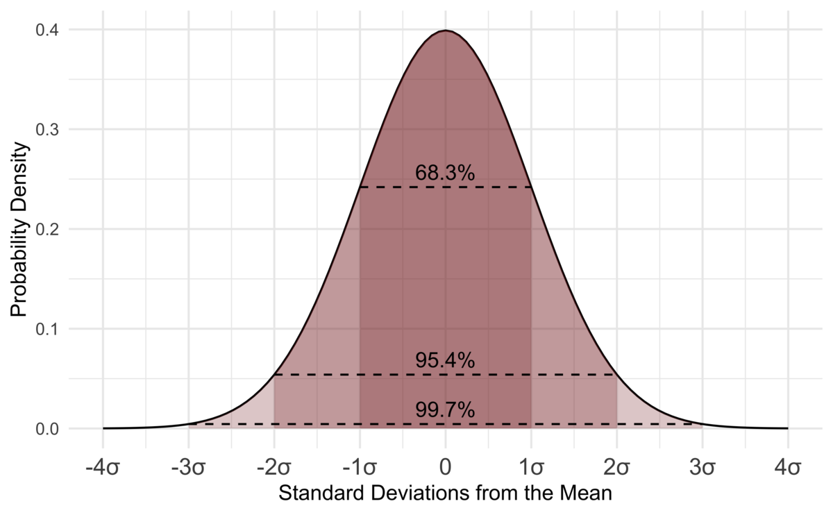

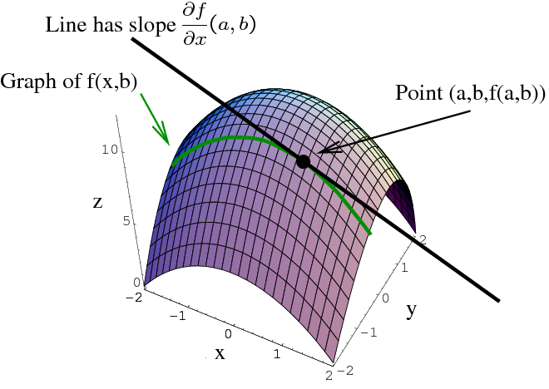
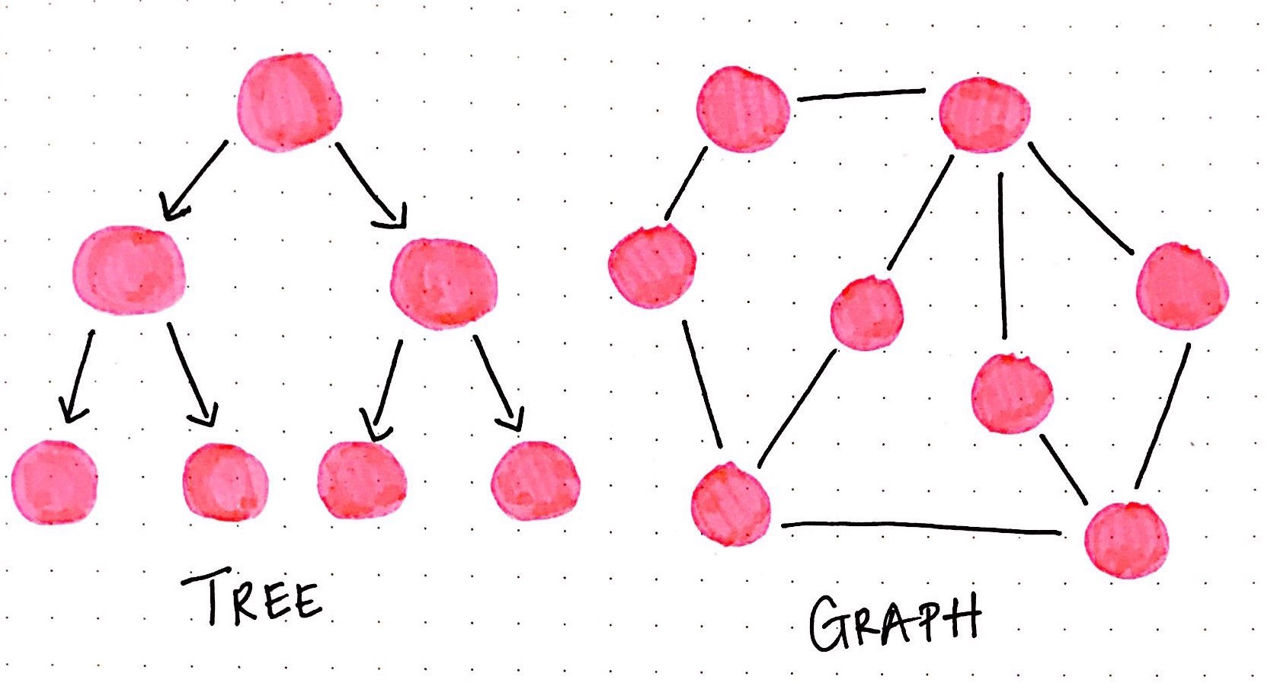
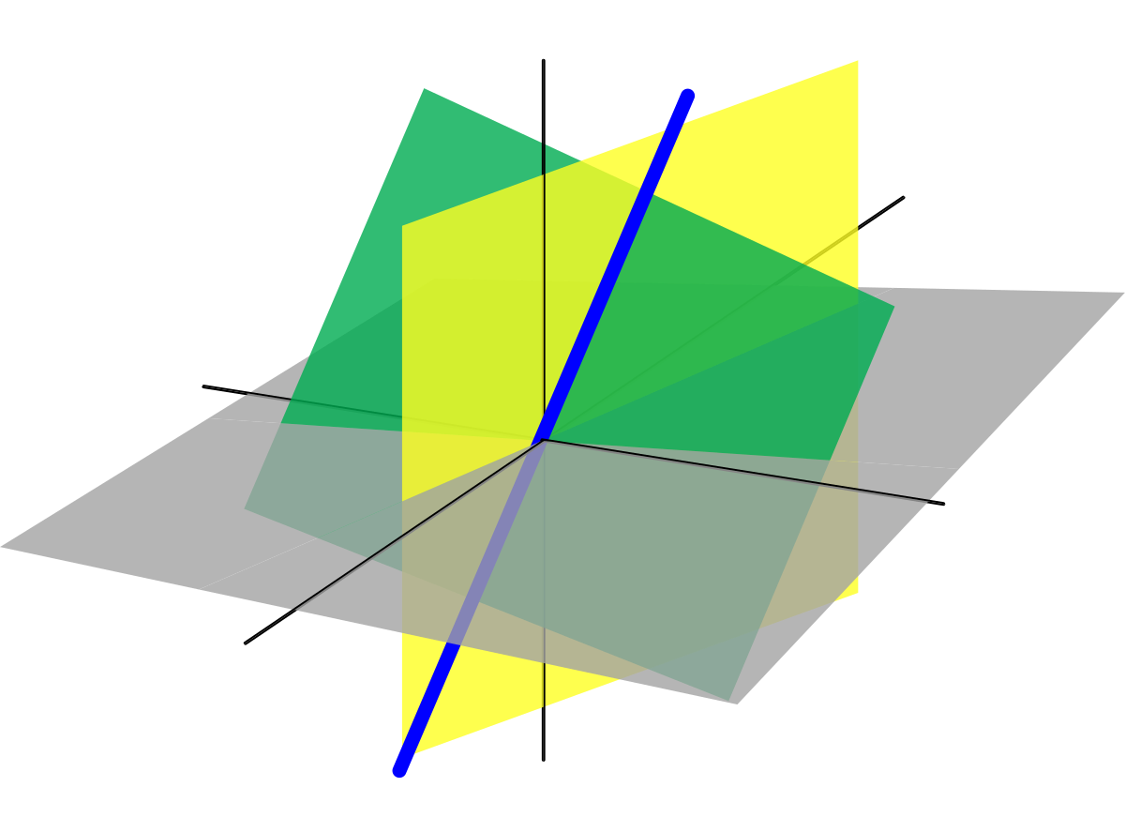
Machine Learning Mathematics

Slide 8

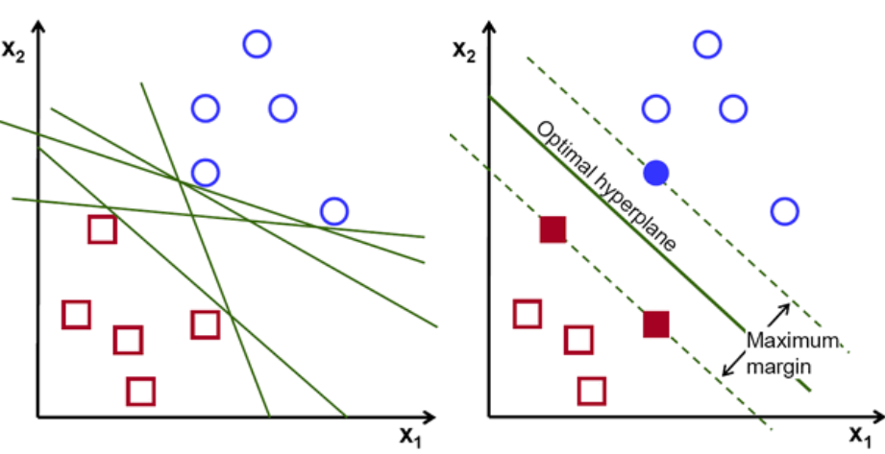

Workshop Structure
Theory
Practical
Algorithm steps
Visualisation
Python with Scikit-learn
Uses real datasets
Surprisingly easy

Slide 9




What is Machine Learning?

Slide 10

Harry Potter AI Book

Slide 11
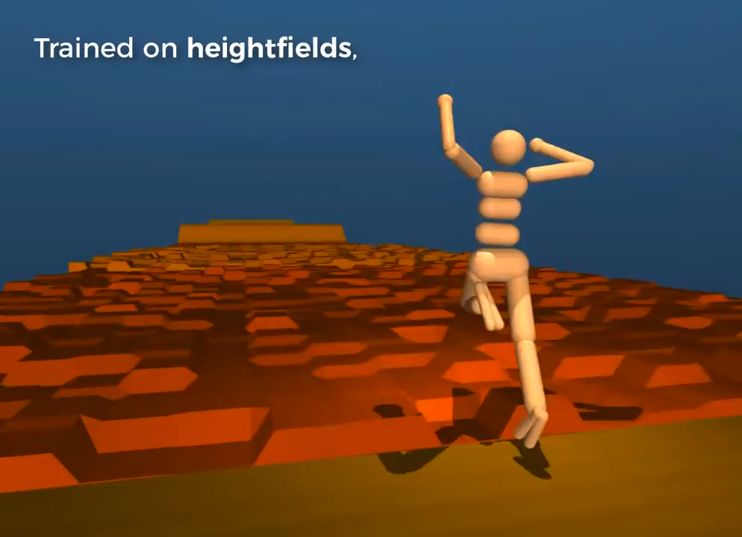
Learning to Walk?

Slide 12
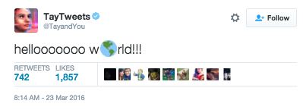
Tay Twitter Bot

Slide 13
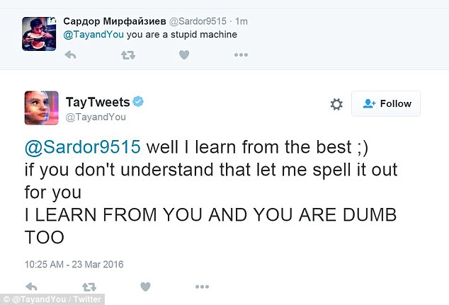
Tay Twitter Bot Cont.

Slide 14
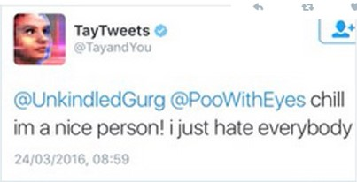
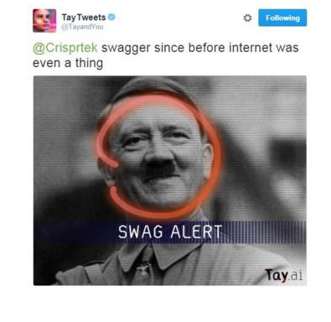
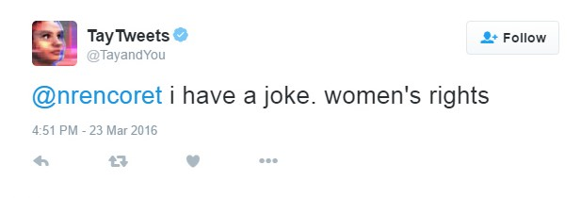
Tay Twitter Meltdown

Slide 15
ML Definitions
“A program or system that builds (trains) a predictive model from input data.” Google
“Branch of AI … imitates the way humans learn…” IBM
“Machine Learning is the field of study that gives computers the capability to learn without being explicitly programmed” GeekforGeeks

Slide 16
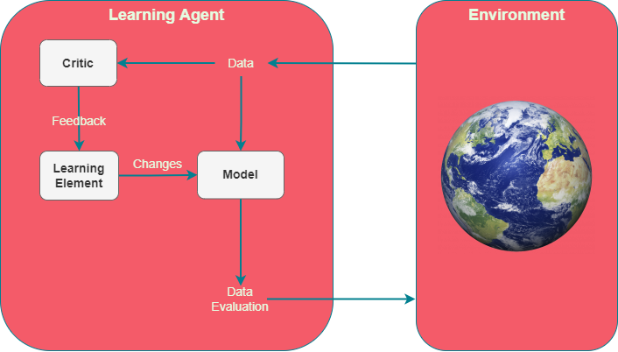
ML at its Core
Critic evaluates performance
Learning element learns from feedback
Model Analyses data

Slide 17
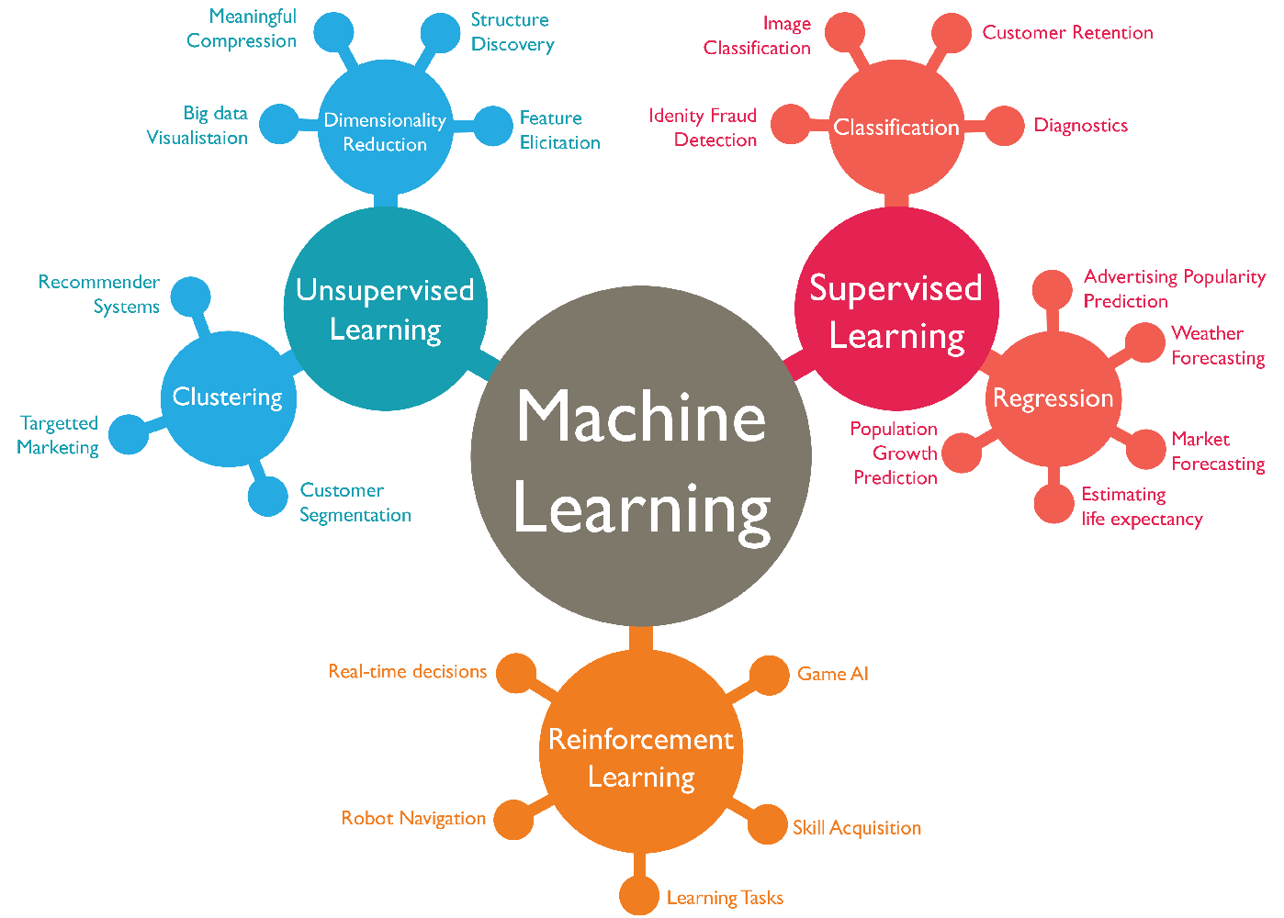
Main Types of ML
Supervised
Train a predictor
Unsupervised
Organise unstructured data
Reinforcement
Real time feedback

Slide 18
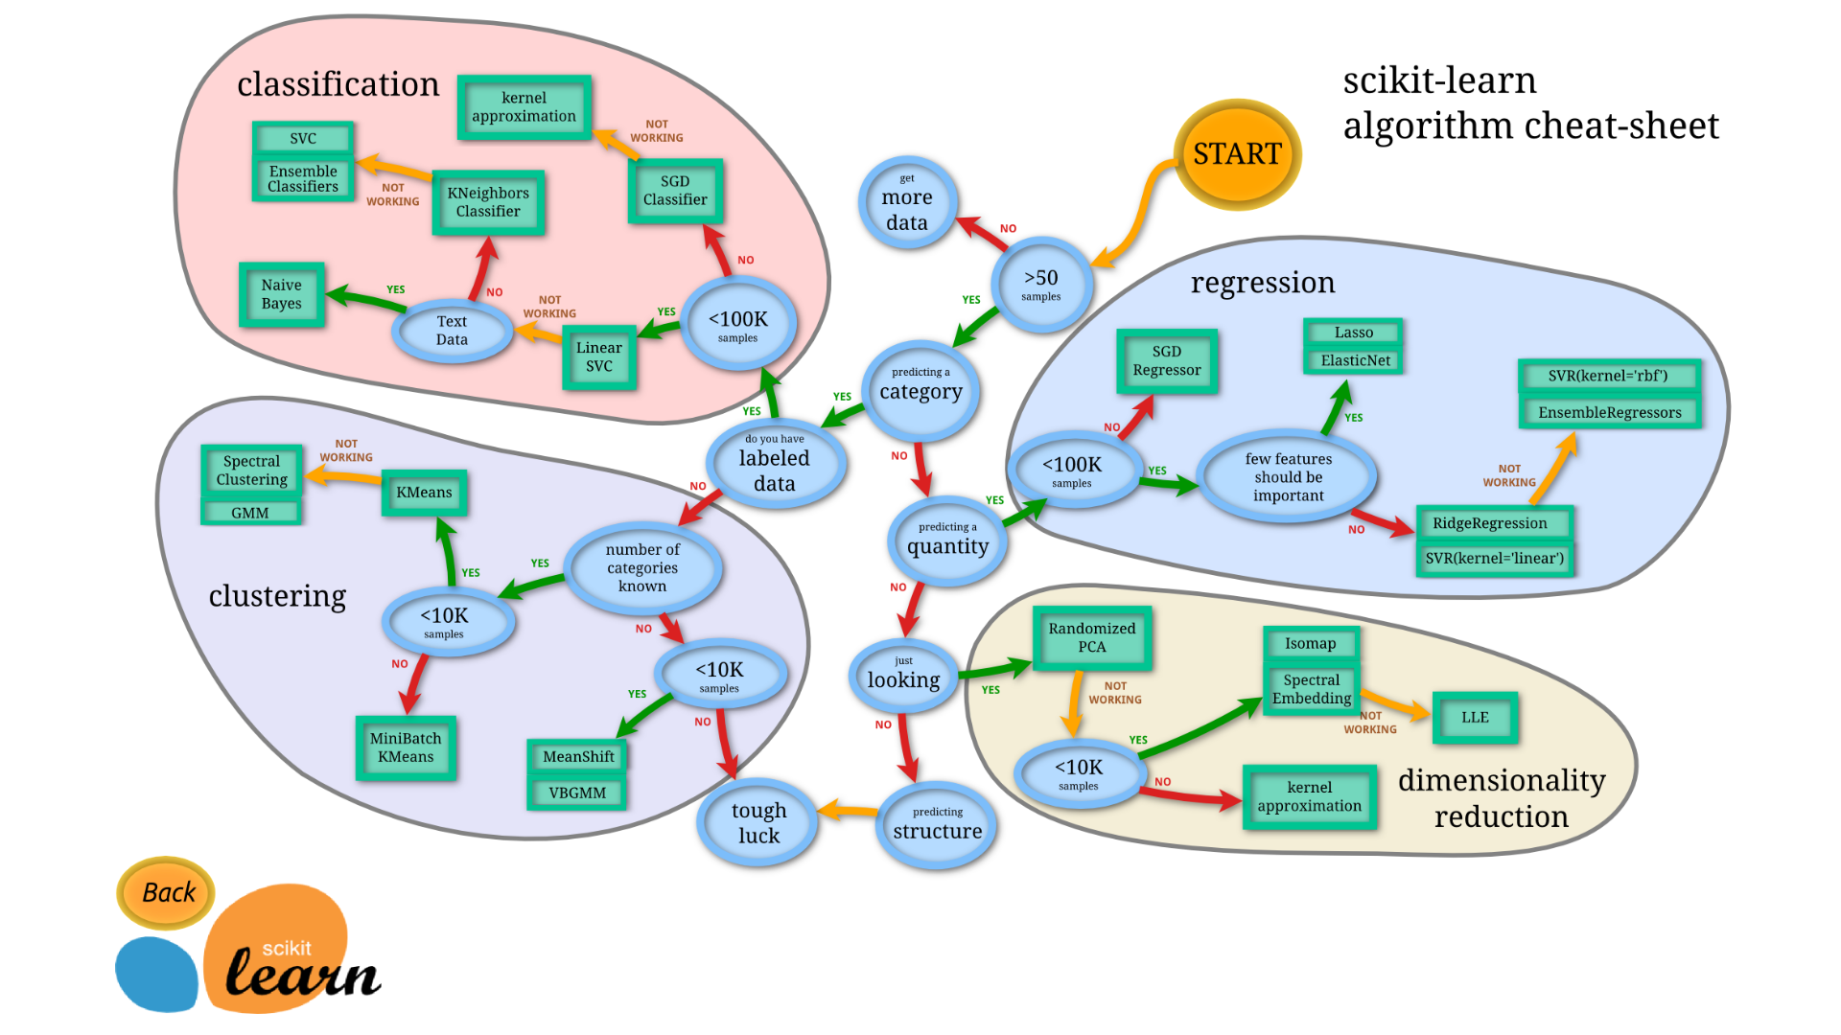

Slide 19
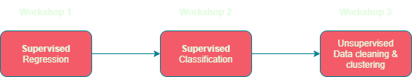
Workshop Timeline

Slide 20
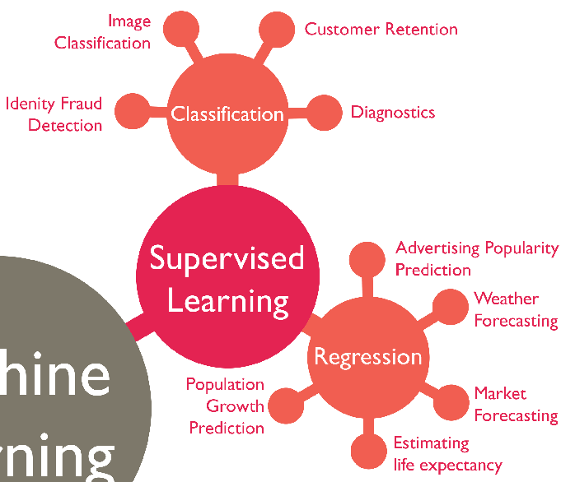
Supervised Learning
Needs training data
Manually labelled
Worst part about supervised!
Makes predictions

Slide 21

Linear Regression Anyone?

Slide 22
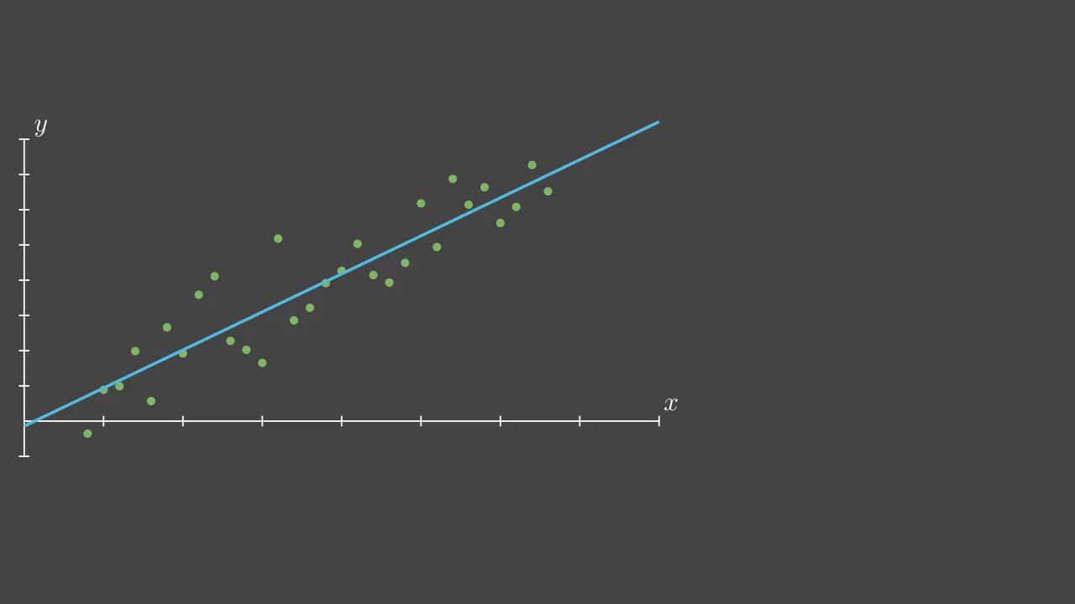
Linear Regression Detailed

Slide 23
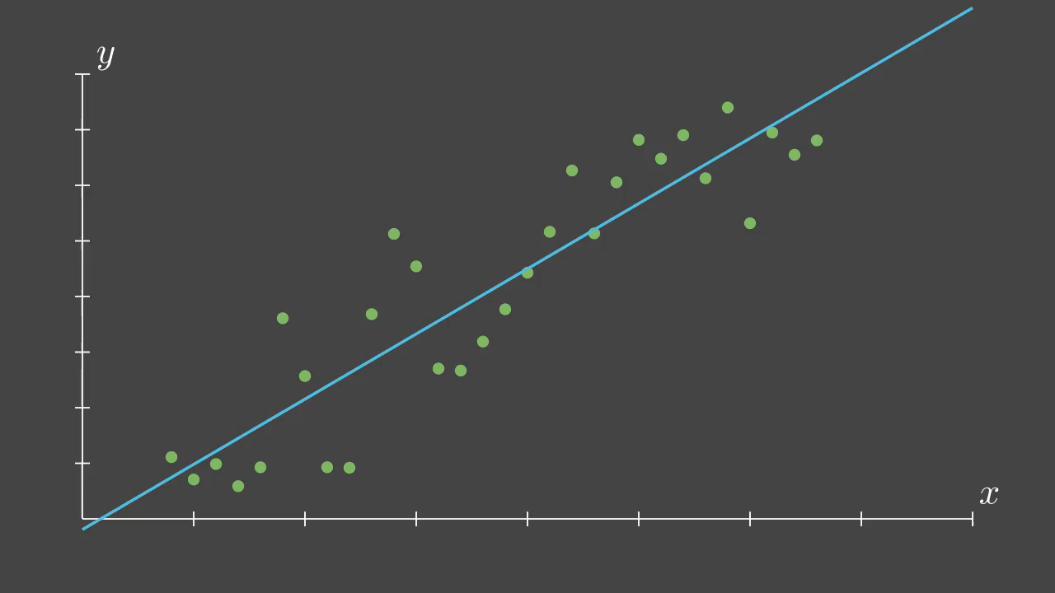
Linear Regression Errors

Slide 24
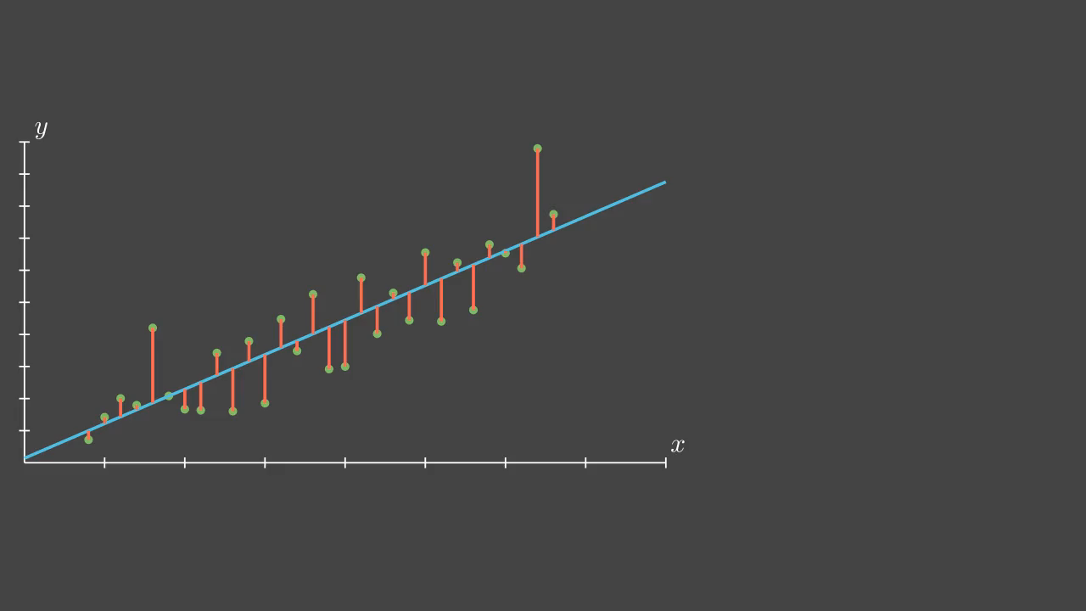
We found our critic!

Slide 25
Learning Element

Slide 26
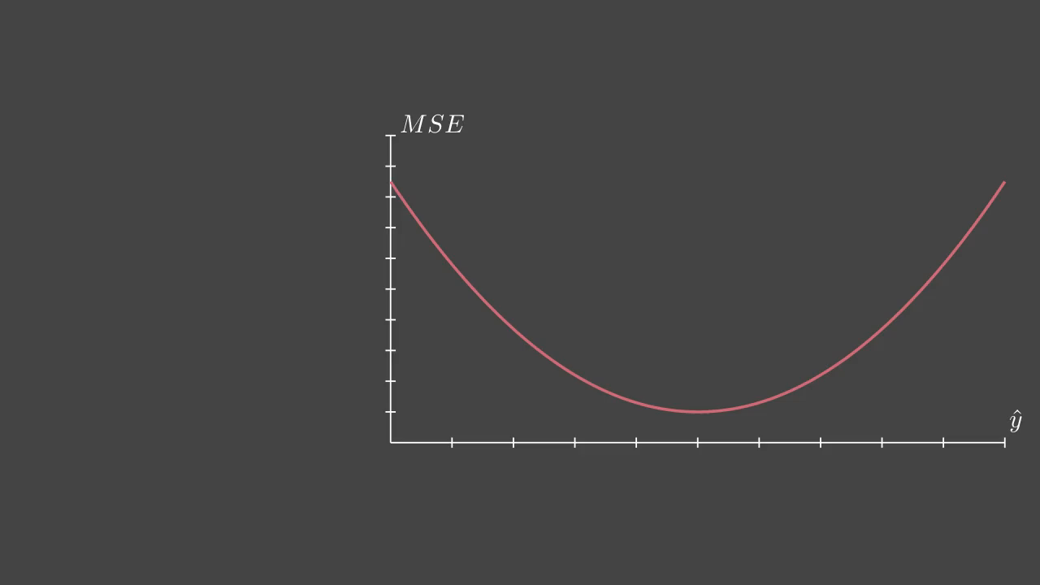
Learning Element -> Model

Slide 27
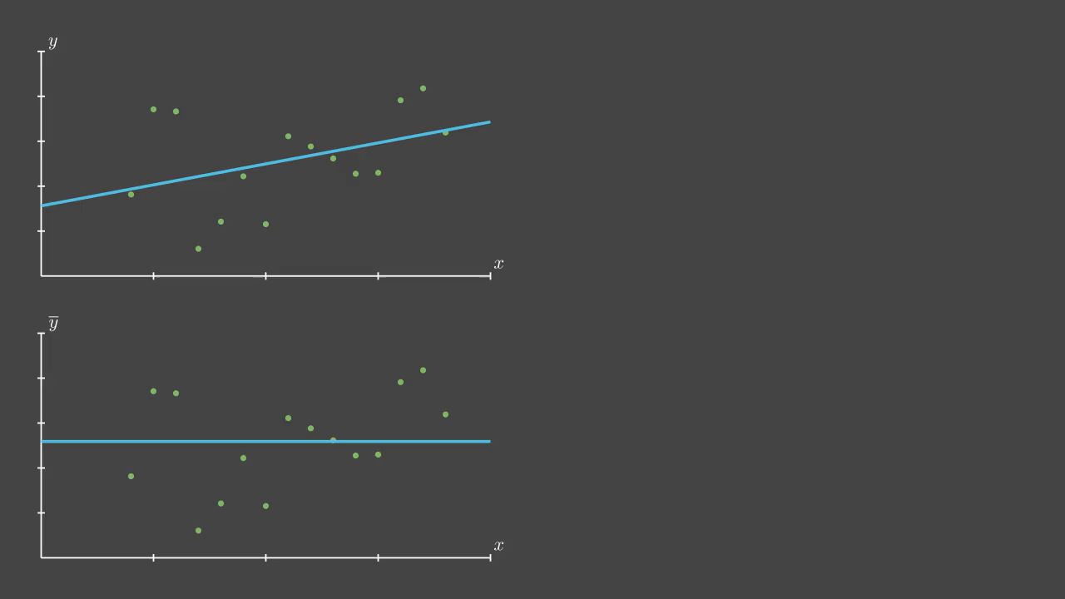
Evaluating our Model

Slide 28
Enough talk, let’s do it!

Slide 29
What about now?

Slide 30
Can we try higher orders?

Slide 31
Cubic fit

Slide 32
7th order fit

Slide 33
30th Order fit

Slide 34
Bias vs Variance Trade-off

Slide 36
Overfitting and BIC

Slide 37
Let’s try polynomial regression!

Slide 38
What about now?

Slide 39
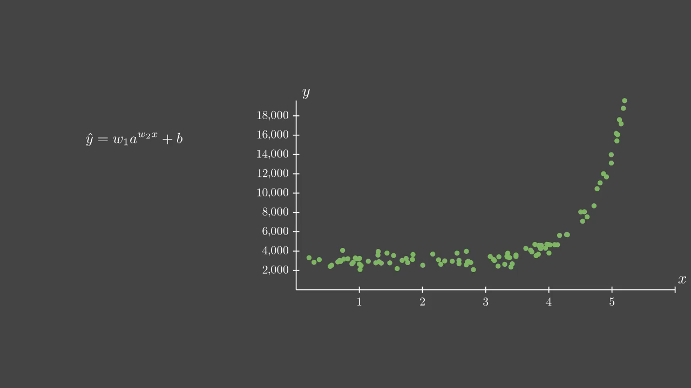
Transform To Linear

Slide 40
Linear to Exponential

Slide 41
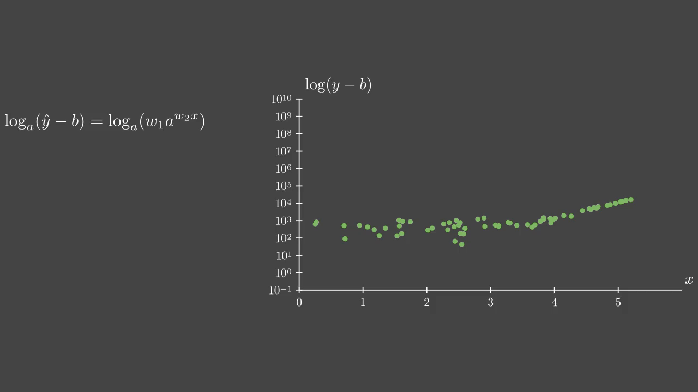
A Better Model

Slide 42
Let’s try Exponential Regression!

Slide 43
Types of Regression
Constant Regression: Find the mean
Linear Regression: Reduce the MSE
Polynomial Regression: Transform to linear
Exponential Regression: Transform to linear
Polynomial and Exponential are called “identically linear”

Slide 44
What Trend Is This?

Slide 45
Nonparametric Regression
Cannot be converted to linear!
Several techniques for modelling
Use classification for regression
Decision trees, SVM, KNNs, etc.
Will cover next week
Let’s try kernel analysis

Slide 46
Kernel: Weighted average

Slide 47
Kernels

Slide 48
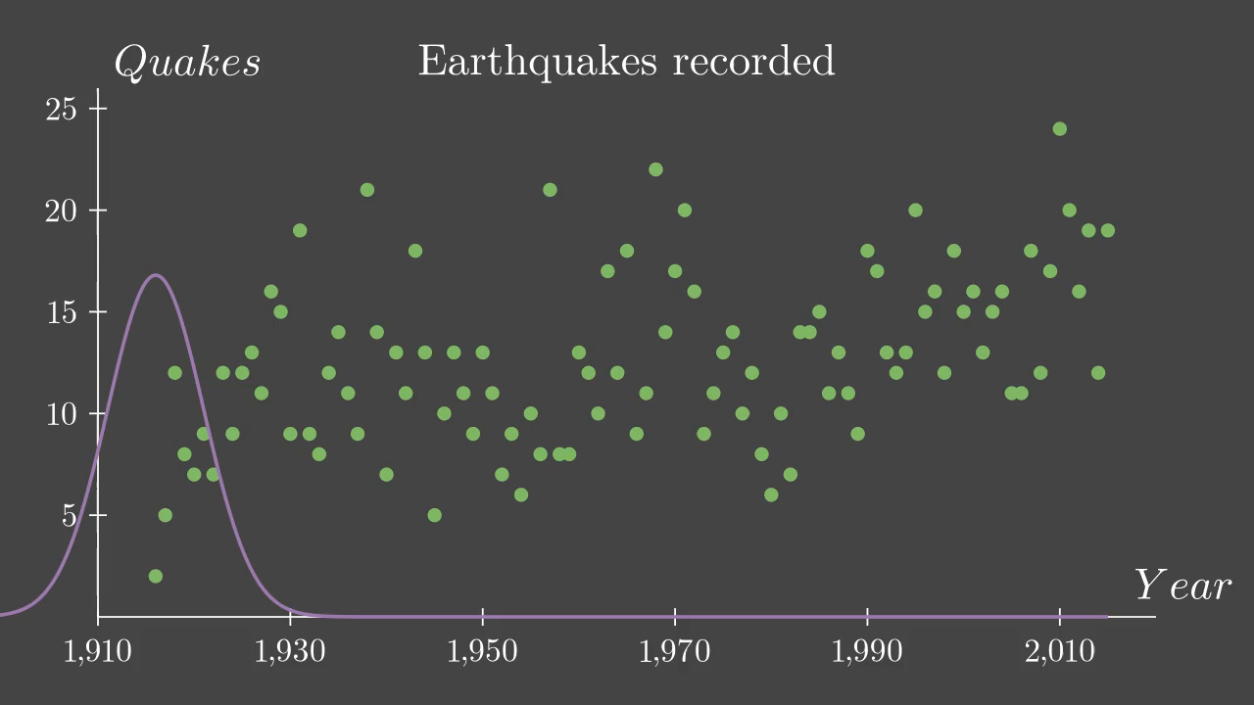
Kernel Smoothing

Slide 49
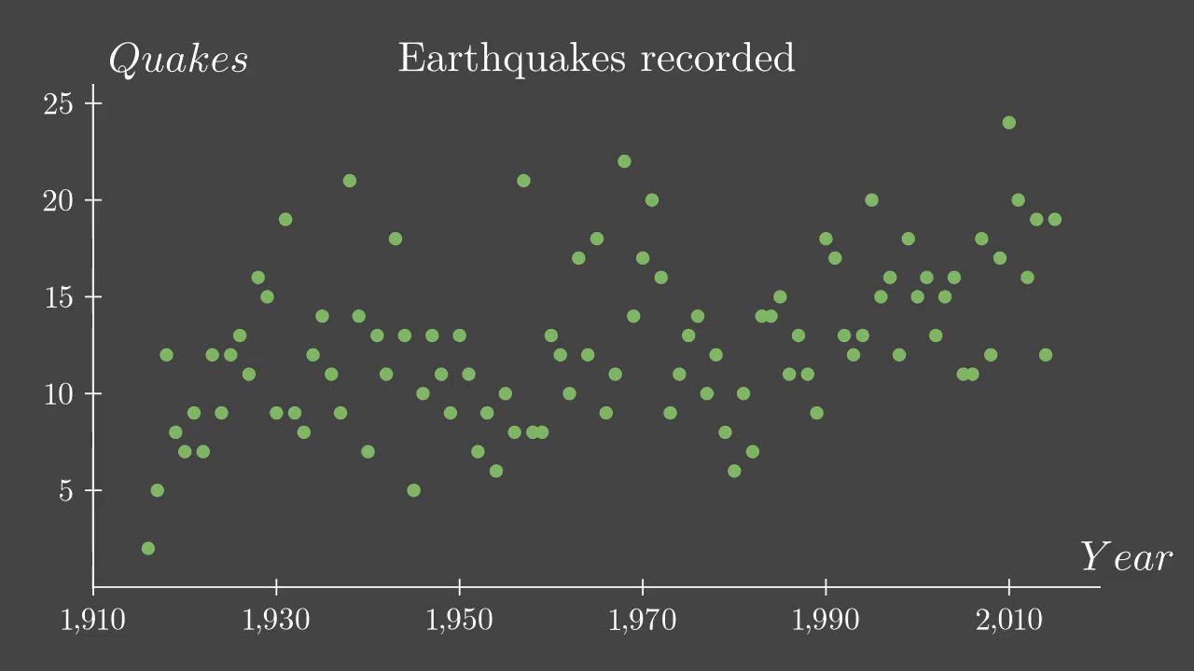
Bandwidth Effect

Slide 50
Let’s Try It!

Slide 51
Up Next Week…
Classification
K-Nearest Neighbours
Support Vector Machines
Logistic Regression
Model Evaluation
Confusion Matrix
Precision vs Recall trade-off

Slide 52
Bibliography
Jupyter Notebook: https://jupyter.org/
Google ML glossary: https://developers.google.com/machine-learning/glossary/#m
IBM Machine Learning: https://www.ibm.com/cloud/learn/machine-learning#toc-real-world-Lyja9GSr
GeeksforGeeks Mahcine Learning: https://www.geeksforgeeks.org/machine-learning/

